Slide 1
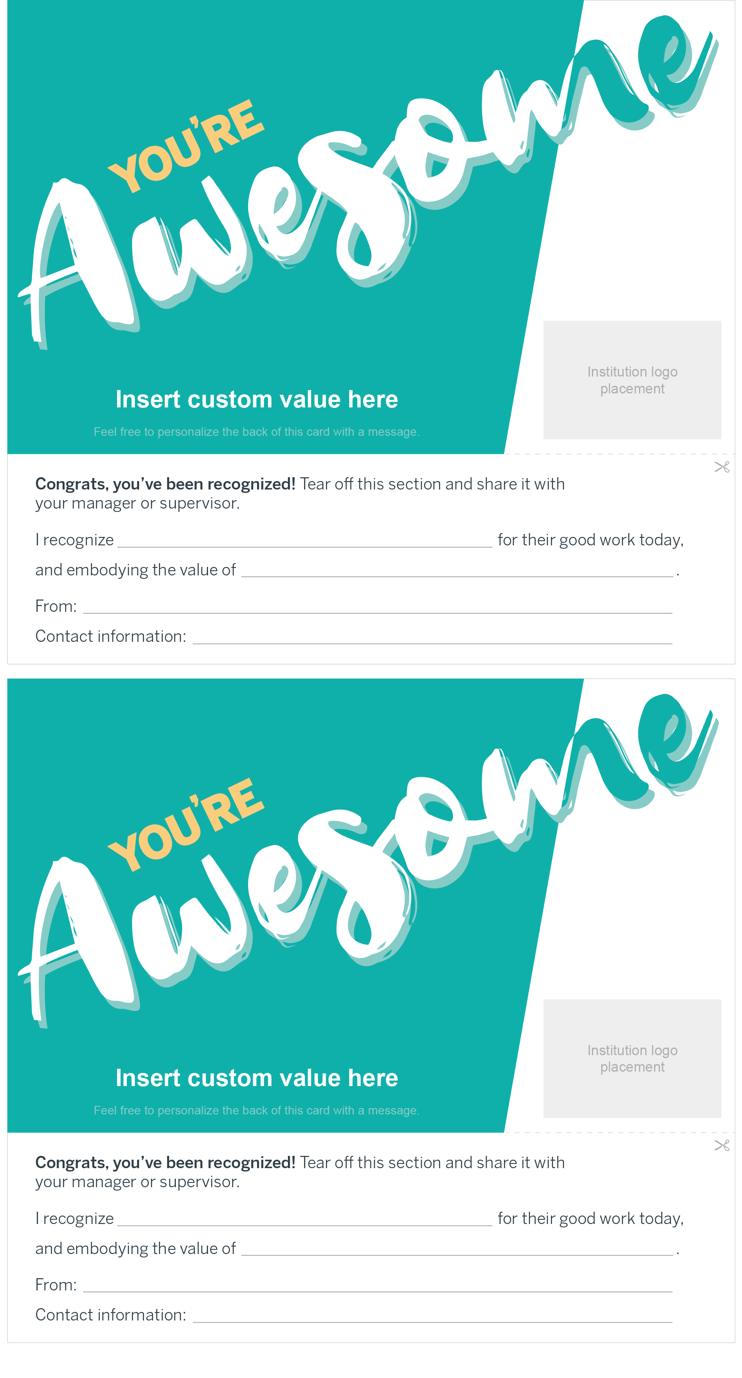
Using the customizable recognition card
Meaningful recognition doesn’t have to come from formal awards and ceremonies. Instead, staff want to feel appreciated for their daily contributions and valued both as professionals and as people.
Use our customizable staff recognition cards to easily build appreciation into your employees’ daily work.
Print the cards on the following pages in color or black and white, cut them out, and share them with your team to use!
Customize this field with one of your organization or department’s core values.
Complete this section so the person you’re recognizing can share it with their manager.
If desired, add your organization’s logo for more meaningful branding.

